Slide 1

State Management using NGXS
By: Bhawna Gunwani

Slide 2
NGRX vs. NGXS

Slide 3
NGRX vs. NGSX
The big question on everybody’s mind is how does NGXS compare to NgRx?
If we compare NGXS and NGRX, both are state management libraries that can use Angular applications.
There are certain advantages of NGXS when working on the development of the Angular application and we want to point them out to you in the first place.
Similarities
Both libraries…
use a unidirectional data flow (Redux, CQRS)
use a single immutable data store
are compatible with Redux dev tools
Page 3

Slide 4
NGRX vs. NGSX
Differences
NGXS does not use switch-style reducers, but gives you a StateContext object to mutate the store in response to an action.
It allows you to perform async operations within the state context (as opposed to listening to an Action stream).
NGSX uses a @select decorator to slice state.
This can pluck a snapshot of the state as a plain JS object.
NGSX supports plugins.
Page 4

Slide 5
So which one is better?
There’s no right answer here.
NgRx is a well-maintained and stable library with a track record in the wild;
But NGXS offers significant advantages in boilerplate reduction, code readability, and extendibility.
Give both of them a test drive and choose the one feels right - or none at all - state management libraries are optional after all.
Page 5

Slide 6
What is NGXS?

Slide 7
What is State?
In the bigger apps, managing the data states is very complicated.
In angular, each component has its own state, to share the data/state between the components.
Normally, we use @Input and @Output decorators, but when the application goes bigger, its challenging to maintain the data consistency.
So to solve this problem, redux was introduced.
It provides a central store that holds all states of your application.
Each component can access the stored state without sending it from one component to another.
Page 7

Slide 8
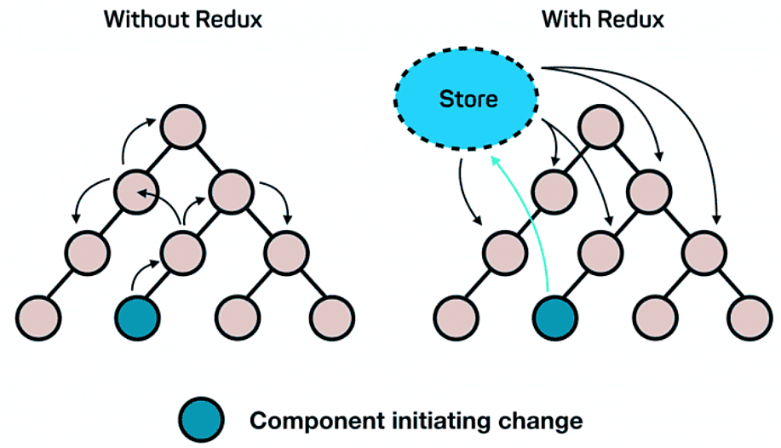
What is State?
Page 8

Slide 9

What is NGXS?
NGXS is a state management pattern + library.
It provides a predictable state management solution inspired by Redux.
NGXS is modeled after the CQRS pattern popularly implemented in libraries like Redux and NgRx.
It reduces boilerplate by using modern TypeScript features such as classes and decorators.
NGXS provides built-in support for TypeScript decorators, state snapshots, time-travel debugging, and async actions.
Page 9

Slide 10
NGXS Advantages
Simplicity
01
Type-Safety
02
Developer Productivity
03
04
Angular Integration
Predictable State Management
05
Page 10

Slide 11
Service API

Slide 12
Service API
Service API is a service that encapsulates interaction with external APIs within the context of state management.
These services are typically used within NGXS effects to handle asynchronous operations,
- such as fetching data from a server, interacting with a database, or performing other side effects.
Component 1
Get Request
SERVICE
(Get, Post, Put, Delete)
GET PRODUCTS
SERVICE
(API)
Http Response
Send Request
Component 2
Get Request
Http Request
ADD PRODUCT
Send Request
Page 12

Slide 13
Service API
State
Component 1
Select
GET PRODUCTS
Action(Dispatch)
SERVICE
(API)
Select
Send Request
Get Data
Component 2
Action(Dispatch)
Http Response
ADD PRODUCT
SERVICE
(Get, Post, Put, Delete)
Http Request
Page 13

Slide 14
How NGXS Works?

Slide 15
How NGXS Works?
NGXS is made up of four main components:
These components create a unidirectional circular control flow from the component to the store (via Actions) and back to the component (via Selects).
Store
Actions
State
Select
Page 15

Slide 16
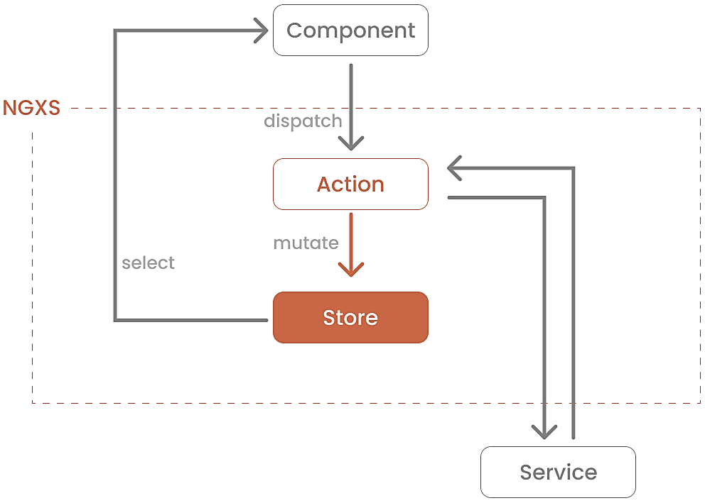
How NGXS Works?
Page 16

Slide 17
Store
The Store is a central repository that holds the entire application state.
It provides a single source of truth for the state of the application.
It allows components and services to interact with and modify the state in a predictable and consistent manner.
We can dispatch the actions to perform certain operations.
this.store.dispatch(new TodoActions.AddTodo(form));
Page 17

Slide 18
Actions
Actions in NGXS are plain TypeScript classes that represent events or commands that trigger state changes.
They are dispatched by components or services to request state changes in the application.
Actions are the primary mechanism for communicating intents to modify the application state in NGXS.
export class AddTodo {
static readonly type = '[Todo] Add';
constructor(public payload: ITodo) { }
}
Page 18

Slide 19
State
A state is a representation of a specific portion of the application's state.
It encapsulates the data and behavior related to a particular feature or domain within the application.
Each state in NGXS typically represents a single concern or feature within the application.
For example, you might have a state for managing user authentication, another state for managing a shopping cart, and so on.
import { Injectable } from '@angular/core';
import { State } from '@ngxs/store'; @State<ITodoStateModel[]>({
name: 'todoList',
defaults: {
todoList: [], },
})
@Injectable()
export class TodoState {}
Page 19

Slide 20
Select
A state is a representation of a specific portion of the application's state.
It encapsulates the data and behavior related to a particular feature or domain within the application.
Each state in NGXS typically represents a single concern or feature within the application.
For example, you might have a state for managing user authentication, another state for managing a shopping cart, and so on.
@Select(TodoState) todoList$: Observable<ITodo>;
Page 20

Slide 21
DEMO:
Installation an Configuration of NGXS

Slide 22
Install NGXS
You can use npm or yarn to install NGXS’s dependencies.
Using npm:
Using yarn:
npm install @ngxs/store –save
yarn add @ngxs/store
Page 22

Slide 23
Architecture of NGXS

Slide 24
How does State Management Works in Angular using NGXS?

Slide 25
How State Management Works?
NGXS utilizes the CQRS pattern for state management in Angular applications.
This separates actions that modify the state (commands) from functions that read the state (queries).
Here's a breakdown of the process:
Components Trigger Actions:
Your Angular components initiate the state update process.
They dispatch an action, which is a plain TypeScript class representing an event that causes a state change.
Actions often carry data (payload) relevant to the update.
Page 25

Slide 26
How State Management Works?
Actions sent to Store:
The dispatched action is sent to the NGXS store.
This store acts as a centralized location for the application's state.
State Update Logic:
The store identifies the appropriate state class based on the action type.
A handler function defined within this state class is then invoked with the action's payload (if any).
This handler function performs the logic required to update the state based on the action.
Page 26

Slide 27
How State Management Works?
Selectors update components:
Selectors are pure functions decorated with @Selector.
They cannot modify the state directly, but instead extract data or derived information from the state in the store.
Components can subscribe to selectors to get notified whenever relevant part of state changes due to an action.
Components React to Changes:
Upon receiving a notification from selector, subscribed components can update their view to reflect new state.
This unidirectional flow ensures predictable state changes and simplifies debugging.
Page 27

Slide 28
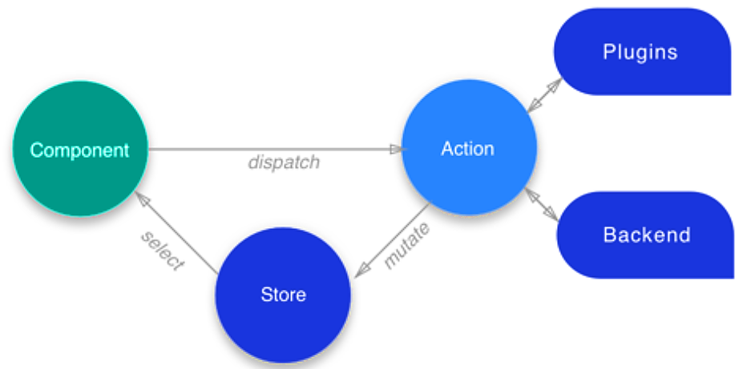
How State Management Works?
Here's an analogy:
Imagine the state as a container holding all your application's data.
Actions act like instructions on how to modify the contents of this container.
The store manages the container and ensures updates follow the defined instructions.
Selectors act like tools that allow components to peek inside the container and see specific parts of the data.
Page 28

Slide 29
Action Handler and Action Life Cycle

Slide 30
Action Handlers
Action handlers are Observables defined within your state class.
They receive all actions dispatched in the application, including those targeting a different state slice.
This allows for centralized logic or reactions to specific actions across the application.
Any action in NGXS can be in one of four, these states are DISPATCHED, SUCCESSFUL, ERRORED, CANCELED.
You can think of it as a finite state machine.
Page 30

Slide 31
Action Handlers
Since it's an Observable, we can use the following pipes:
ofAction: triggers when any of the below lifecycle events happen
ofActionDispatched: triggers when an action has been dispatched
ofActionSuccessful: triggers when an action has been completed successfully
ofActionCanceled: triggers when an action has been canceled
ofActionErrored: triggers when an action has caused an error to be thrown
ofActionCompleted: triggers when an action has been completed whether it was successful or not (returns completion summary)
Page 31

Slide 32
Action Lifecycle
Actions in NGXS also have a lifecycle.
Since any potential action can be async we tag actions showing when they are "DISPATCHED", "SUCCESSFUL", "CANCELED" or "ERRORED".
This gives you the ability to react to actions at different points in their existence.
Dispatched
ERRORED
CANCELED
SUCCESSFUL
Page 32

Slide 33
Cancellation and Composition

Slide 34
Cancellation and Composition
In NGXS, These are the techniques used to manage side effects, particularly in scenarios involving asynchronous operations triggered by dispatched actions.
While NGXS itself doesn't provide built-in support for cancellation or composition.
Developers can implement these patterns using middleware and effects.
Page 34

Slide 35
Cancellation
To implement cancellation, developers can leverage middleware to intercept actions before they reach reducers.
Middleware functions can check for certain conditions or criteria and decide whether to allow the action to proceed or cancel it.
Example: Suppose you have an action that triggers an asynchronous operation, such as fetching data from an API.
Before dispatching the action, you can intercept it with middleware and check if there's already a similar pending request. If there is, you can cancel the new action or queue it for later processing.
Page 35

Slide 36
Cancellation
// Sample middleware for cancellation
export function cancelDuplicateRequestsMiddleware(ctx: StateContext<any>, action: any, next: any) {
const isDuplicateRequest = /* Check if there's already a similar pending request */;
if (isDuplicateRequest) {
// Cancel the action
return EMPTY; }
return next(ctx, action);
}
Applying Middleware:
Middleware functions can be applied globally to intercept all dispatched actions or selectively to actions.
By applying cancellation middleware, developers can prevent unnecessary or duplicate side effects triggered by actions.
Page 36

Slide 37
Composition
Composition refers to combining multiple side effects into a single coherent operation.
Developers can achieve this by using effects (functions that handle side effects triggered by dispatched actions).
Example: Suppose you have multiple actions that trigger different asynchronous operations, such as fetching user data, fetching product data, and updating user preferences.
Instead of handling each operation separately, you can compose them into a single effect that orchestrates the sequence of operations.
Applying Effects:
Effects are applied to specific actions using the @Effect() decorator and registered with NGXS module providers.
By composing effects, developers can encapsulate complex sequences of side effects and maintain better control over the application's behavior.
Page 37

Slide 38
Composition
// Sample effect for composition
@Injectable()
export class UserDataEffects {
constructor(private userService: UserService, private actions$: Actions) {}
@Effect()
loadUserData$: Observable<any> = this.actions$.pipe(
ofType(UserActions.LoadUserData),
switchMap(() => this.userService.getUserData()),
map(userData => UserActions.LoadUserDataSuccess({ userData })),
catchError(error => of(UserActions.LoadUserDataFailure({ error })))
);
}
Page 38

Slide 39
Error Handling

Slide 40
Error Handling
NGXS uses Angular's default ErrorHandler class, so if an action throws an error, Angular's ErrorHandler is called.
You can easily override this flow by providing your own handler like so:
import { NgModule, ErrorHandler } from '@angular/core';
@Injectable()
export class MyErrorHandler implements ErrorHandler {
handleError(error: any) {
console.log('ERROR! ', error);
// Make sure to rethrow the error so Angular can pick it up
throw error;
}
}
@NgModule({
imports: [AppComponent],
providers: [
{
provide: ErrorHandler,
useClass: MyErrorHandler
}
]
})
export class AppModule {}
Page 40

Slide 41
Lazy Loading

Slide 42
Lazy Loading
Lazy loading involves dynamically loading state modules and registering them with the NGXS store when they are needed, typically as part of lazy-loaded feature modules in Angular applications.
While NGXS itself doesn't provide built-in support for lazy loading.
You can implement lazy loading of state modules using standard Angular lazy loading techniques along with NGXS state management.
Stores can be lazy-loaded easily by importing the NgxsModule using the forFeature method.
@NgModule({
imports: [NgxsModule.forFeature([LazyState])]
})
export class LazyModule {}
Page 42

Slide 43
Mapped Sub States

Slide 44
Mapped Sub States
Mapped sub states provide a way to combine or merge multiple dynamic selectors into a single selector.
This can be useful for situations where you need to combine data from different parts of your state tree to display it in your component or perform further calculations.
How it Works?
Define Dynamic Selectors:
You create individual selectors for each slice of state you want to combine.
These selectors are typically functions decorated with @Selector that retrieve specific data from the state.
Page 44

Slide 45
Mapped Sub States
Create Mapped Sub State:
Use the @Selector decorator with the props option to define a mapped sub state.
This decorator takes an array of the dynamic selectors you want to combine as arguments.
Combine Data:
Within the mapped sub state function, you can access the results of the provided dynamic selectors using their property names defined in the props option.
You can then combine or transform this data as needed using plain JavaScript or RxJS operators.
Page 45

Slide 46
Mapped Sub States Example
import { Injectable } from '@angular/core';
import { Selector, StateContext, createSelector } from '@ngxs/store'; export interface UserState {
name: string;
}
export interface CartState {
items: number; }
@State<UserState>({
name: 'user',
defaults: { name: '' },
})
@Injectable()
export class UserState {}
@State<CartState>({
name: 'cart',
defaults: { items: 0 },
})
@Injectable()
export class CartState {}
export const getUserName = createSelector([UserState], (state: UserState) => state.name);
export const getCartItems = createSelector([CartState], (state: CartState) => state.items);
export const getUserAndCartInfo = createSelector([getUserName, getCartItems], (userName, cartItems) => ({
userName, cartItems,
}));
Page 46

Slide 47
Mapped Sub States Example
In this example:
getUserName and getCartItems are individual selectors for each state slice.
getUserAndCartInfo is a mapped sub state that combines the results of the previous two selectors into a single object.
Page 47

Slide 48
Meta Reducers

Slide 49
Meta Reducers
Meta reducers are higher-order reducer functions.
They intercept the action -> reducer pipeline in NgRx (the library upon which NGXS is built).
They operate on the state and action objects before they reach the actual reducers responsible for state updates.
This allows for global modifications or side effects to be applied before the core state update logic is executed.
Below are the reasons to use Meta Reducers (Plugins in NGXS):
Logging
Authentication
Side Effects
Global State Changes
Page 49

Slide 50
Meta Reducers
An example of a meta reducer might be to clear the entire state when a user logs out.
An example implementation would be:
import { getActionTypeFromInstance } from '@ngxs/store';
export function logoutPlugin(state, action, next) {
// Use the get action type helper to determine the type
if (getActionTypeFromInstance(action) === Logout.type) {
// if we are a logout type, lets erase all the state
state = {};
}
// return the next function with the empty state
return next(state, action);
}
Page 50

Slide 51
Meta Reducers
Then we import that like:
import { NgModule } from '@angular/core';
import { NGXS_PLUGINS } from '@ngxs/store';
@NgModule({
imports: [NgxsModule.forRoot([])],
providers: [
{
provide: NGXS_PLUGINS,
useValue: logoutPlugin,
multi: true
}
]
})
export class AppModule {}
Page 51

Slide 52

THANK YOU
Page 52

